Slide 1


JasperGold Formal VRF
TEAM MEMBERS:
1) B. SURYA GANESH
2) V. SRI CHARAN
3) T.D. L.MANOHAR
4) A. SRINIVAS
5) K.L.KAVYA SRI
6) G.DEEVANA

Slide 2
PROBLEM STATEMENT:
Simulation-based verification using Universal Verification Methodology tests only a limited set of input scenarios, so some corner-case bugs or illegal states may remain undetected.
Problem overview:
This project verifies an RTL digital design using both simulation and formal verification concepts similar to Cadence JasperGold to ensure correct behavior in all situations.
Normally the design is tested for ALU operations, FSM state transitions, handshake protocol, security control, and error conditions.
A final verification report is generated showing whether each verification category passes, confirming that the design is functionally correct and reliable.

Slide 3
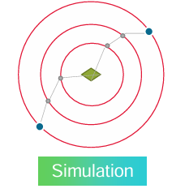
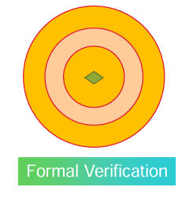
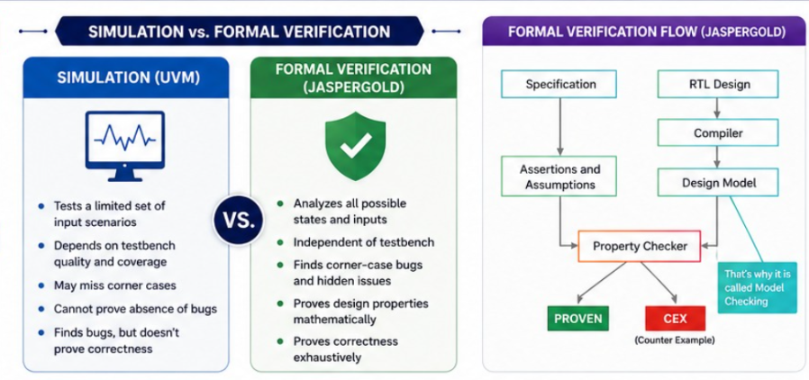
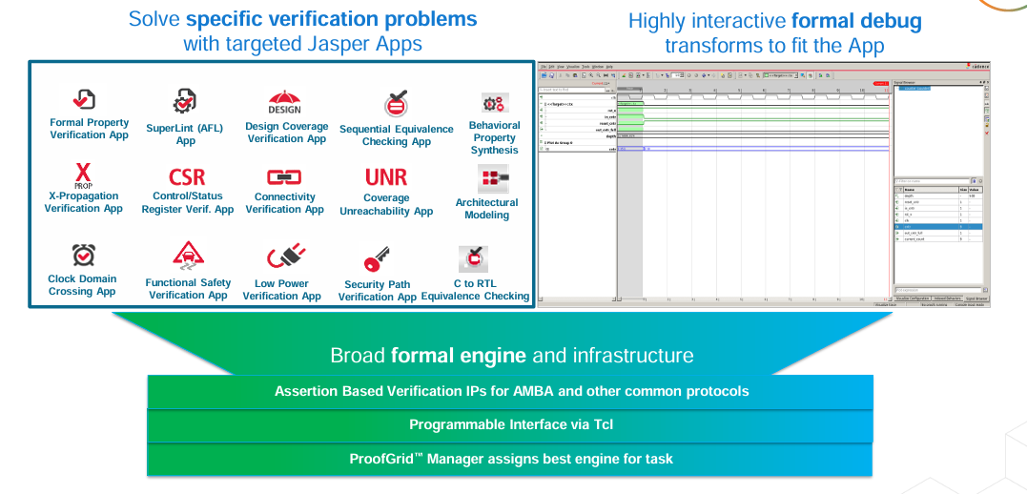
Why Formal verification ?
Jasper formal apps:
Various verification apps based on varying in design parameters.

Slide 4
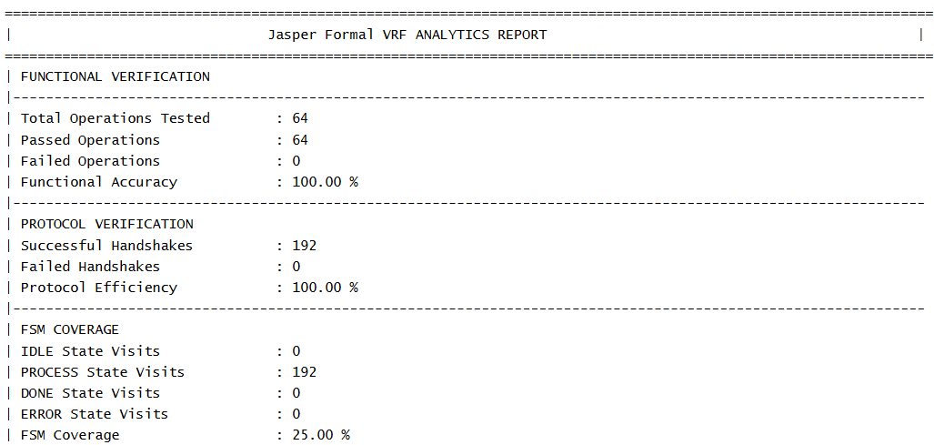
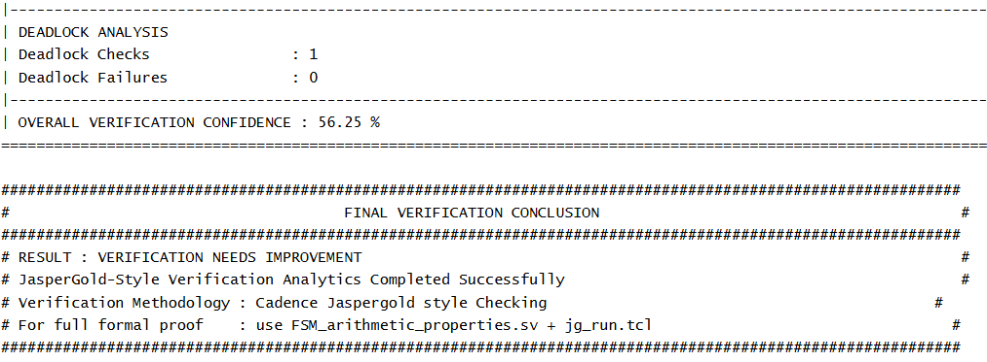
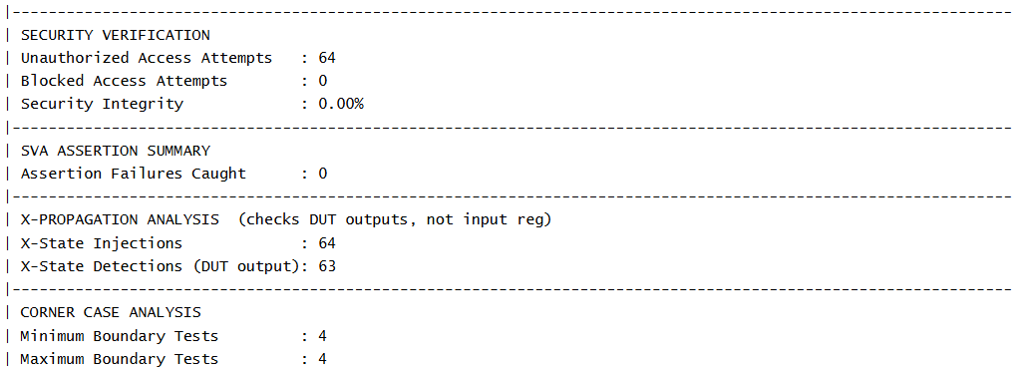
Formal vrf report:

Slide 5
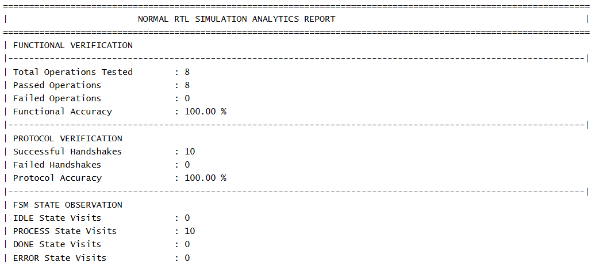
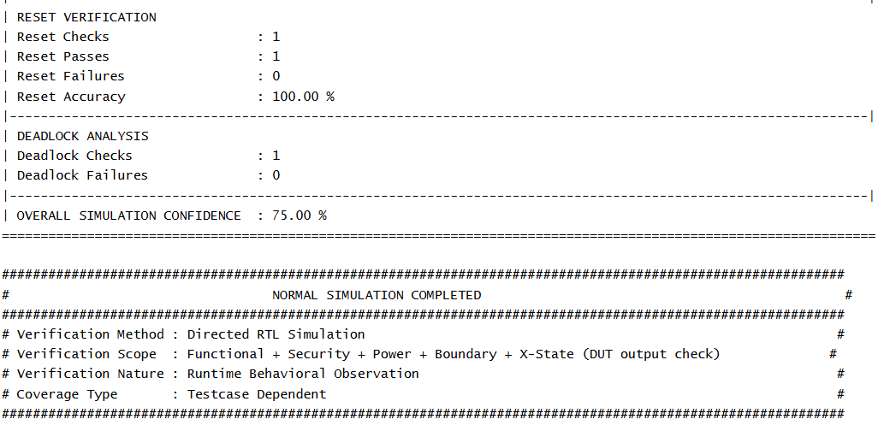
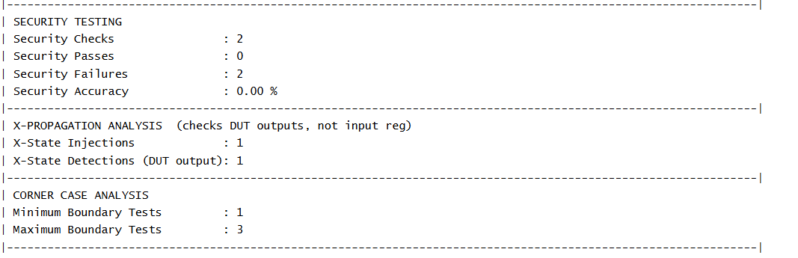
Simulation based report:

Slide 6


Designed and verified an FSM-based secure arithmetic module using Verilog HDL.
Implemented ADD, SUB, AND, and XOR operations with protocol and security control.
Verified the design using both traditional RTL simulation and formal verification techniques.
Simulation checked selected runtime test cases, while formal verification explored wider state and corner-case coverage.
FSM, security, power, and X-state analyses confirmed correct design behavior.
The project demonstrated that formal verification provides higher verification confidence compared to normal simulation.

